Slide 1
Refraction

Slide 2
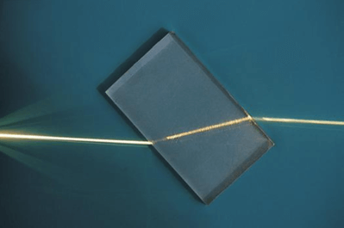
By the end of this lesson, you should be able to:
• | Describe the relationship between the density of a substance and the angle of refraction.
• | Draw a ray diagram to show how light refracts.
• | Identify whether a ray will bend towards or away from the normal as it travels into a different medium.

Slide 3
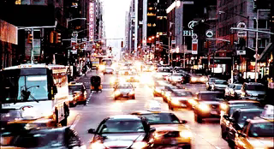
The medium that a light wave is travelling through affects the speed of that light wave.
This is because different media have different densities.

Slide 4
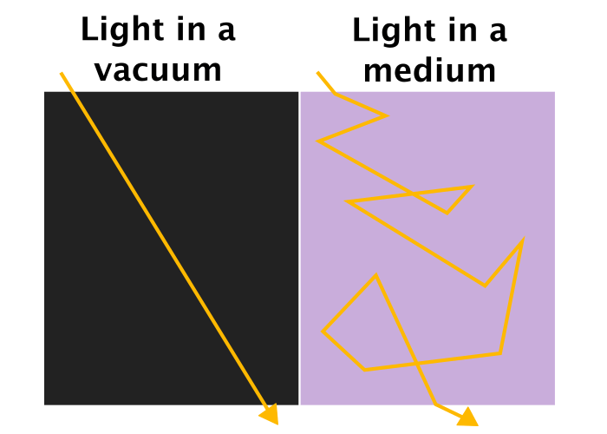
When light moves through a medium, it bounces around between the particles of the medium.
Particles reflect, absorb and redirect light - essentially, light is scattered.
This scattering means that light takes a lot longer to get where it needs to go. Its speed through the medium is slower than the speed of light.
Light travels at light speed between particles, but the scattering means that, overall, it goes slower.

Slide 5
In a vacuum, there are no particles, so light has a straight path from point to point.
This allows it to travel at the speed of light. It is not slowed down by particles getting in the way.
• | Describe the relationship between the density of a substance and the angle of refraction.
• | Draw a ray diagram to show how light refracts.
• | Identify whether a ray will bend towards or away from the normal as it travels into a different medium.

Slide 6

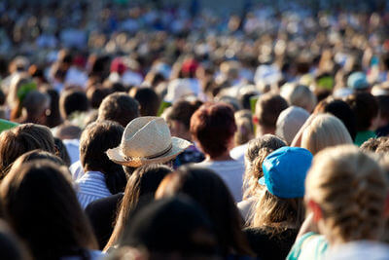
Light passing through a dense medium is like someone trying to run through a densely crowded area.
They still travel at the same speed, but bouncing between people and moving in random directions means that overall they take a lot longer to get through.
VS

Slide 7
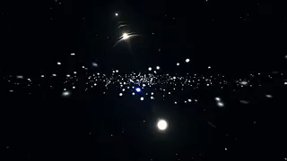
A denser medium has more particles in it.
This causes the light to scatter around the particles and slow down slightly.
A vacuum, like space, has no particles in it. This means that there is nothing to scatter the light and slow it down.
Light travels fastest in a vacuum.

Slide 8

Light travelling at different speeds in different media can have pretty significant effects.
In particular, it causes a phenomenon called refraction to occur.

Slide 9
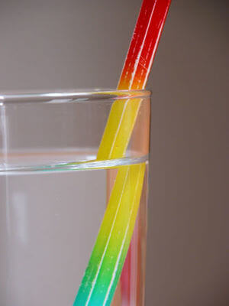
Refraction is a bending of light rays.
It occurs when light travels from one medium into a medium with a different density. We most commonly see this when light travels between air and water. For example, the pencil in the picture to the right looks disjointed. This is due to refraction.

Slide 10
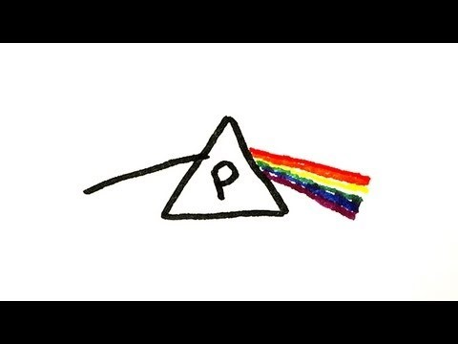

Slide 11
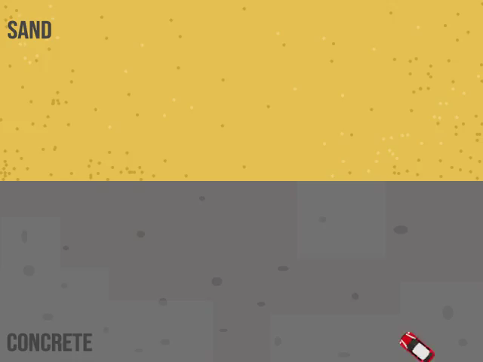
We can use a car to visualise how light rays bend when they are refracted.
Let's imagine a car on concrete driving onto sand (a denser medium) at an angle. The first wheel that touches the sand will slow down, while the other wheels travel at the same speed.
With one wheel going slowly, the car will turn towards the slow wheel. This causes the car to change direction.

Slide 12
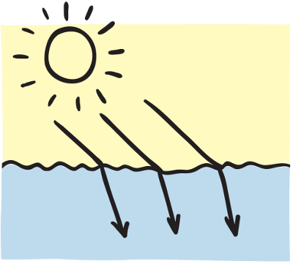
A similar thing happens when light rays travel into a different medium.
When a light ray travels into a denser medium, it will bend.
This is because the light ray travels slower in the new medium.

Slide 13
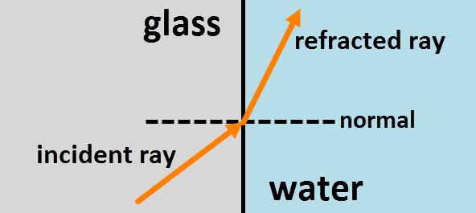
We use ray diagrams to demonstrate how light bends when it passes through different mediums.
The normal is an imaginary line that runs at a 90o angle to the boundary of the media. It is usually represented with a dotted line.

Slide 14
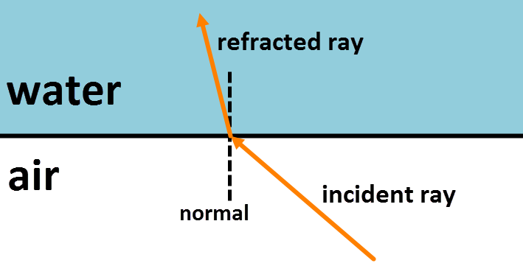
The ray that approaches the place where two mediums meet is called the incident ray.
The ray that leaves is called the refracted ray.

Slide 15
The ray that approaches the place where two mediums meet is called the incident ray.
The ray that leaves is called the refracted ray.

Slide 16
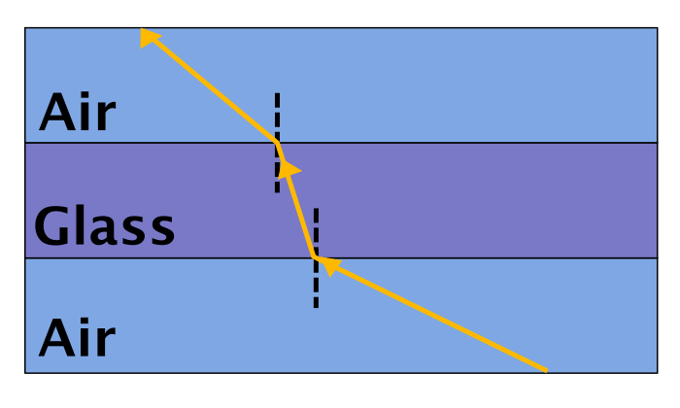
When a light ray travels into a less dense medium, it travels away from the normal.
This is because the ray travels faster in the new medium.
When light travels from air into glass, it bends towards the normal as it slows down. When light leaves the glass and enters air again, the ray bends away from the normal because it can travel faster.

Slide 17
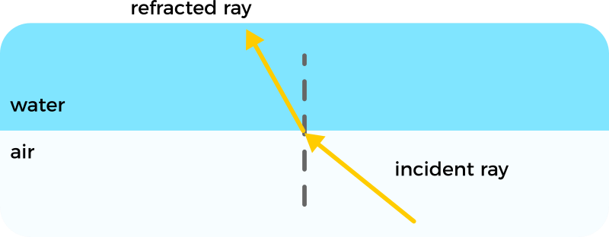
If a light ray travels into a denser medium, it will bend towards the normal.
If it travels into a medium with a lower density, it will bend away from the normal.

